Slide 1
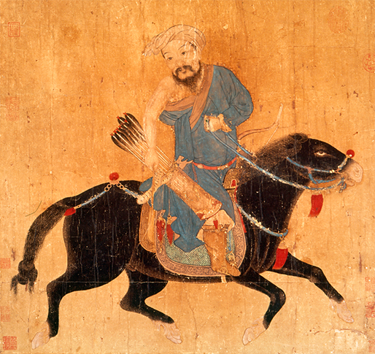
Civilizations of Asia (500-1650)
Lesson 3 The Mongol Empire and Ming China

Slide 2
Civilizations of Asia (500-1650)
Topic 3 Lesson 3 The Mongol Empire and Ming China
Learning Objectives
Summarize how Mongol armies built an empire.
Describe China under Mongol rule.
Understand how the Ming restored Chinese rule.
Explain why the Ming explored the seas for only a brief period.

Slide 3
Mongols Build an Empire
Mongols Conquer China
Mongol armies conquered Asian steppe lands with ease but had issues with walled cities
They had to learn to use gunpowder from the Turks and Chinese in order to fight better.
Genghis Khan will not live to see the conquest of all of China but his heirs for 150 years will continue to dominate Asia
Impact of Mongol Rule
Once Mongols conquered an area they left it alone except the conquered people had to pay their taxes
Mongol rulers were pretty tolerant b/c of the example of Genghis Khan. He listened to people of different faiths and respected city people

Slide 4
Mongols Build an Empire
The Mongol Peace
In the 1200’s and 1300’s G.K. sons and grandsons established peace and order in their domains. This time is known as Pax Mongolica
Trade will flourish across Eurasia
From China gunpowder use will make it to Europe
Papermaking techniques will also make it to Europe
Crops and trees will come from the Middle East into East Asia

Slide 5
Mongols Build an Empire
Mongol archers on horseback, as shown in this Ming illustration, were tough warriors who could swiftly shoot arrows at enemies from all sides.

Slide 6
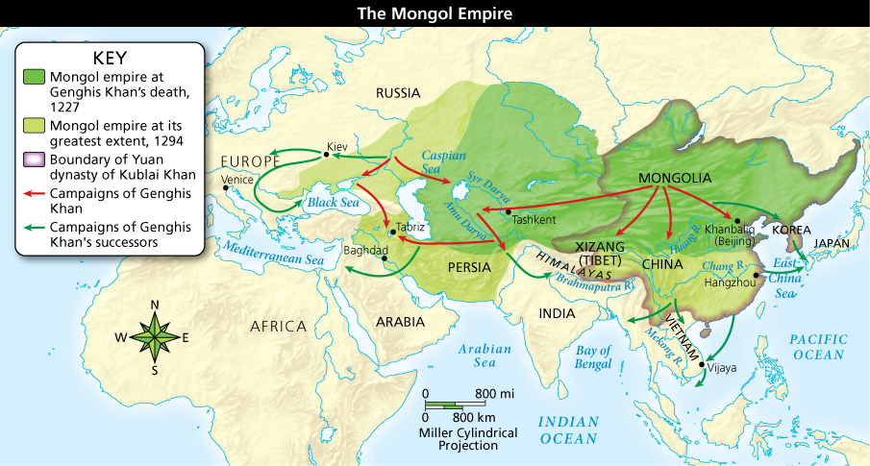
Mongols Build an Empire
Analyze Maps At its height, the Mongol empire was the world’s largest up to that time. Describe the growth of the empire between 1227 and 1294. Did Genghis Khan or his successors conquer the most land?

Slide 7
Mongols Rule China
Government
Kublai will separate Mongols from Chinese
The name of his dynasty will be the Yuan dynasty
Only Mongols can serve in the military
Mongols and a few non Chinese people will hold important govt. positions
Chinese officials will still rule provinces
Kublai will build a walled city in Chinese fashion but the architecture in his palace will be Arab
Contact b/w Asia and Europe will continue. Pope will send priests, Muslims will set up communities, and goods like gunpowder, porcelain, and cards will go to Europe

Slide 8
Mongols Rule China
Marco Polo Describes China
In 1271 Marco leaves with his uncle and father to China
He spends 17 years under the service of Kublai
When he returns back to Venice he will describe the wealth and splendor of China
He describes the palace and mail service
This will spark interest in Asia’s riches by Europeans.

Slide 9
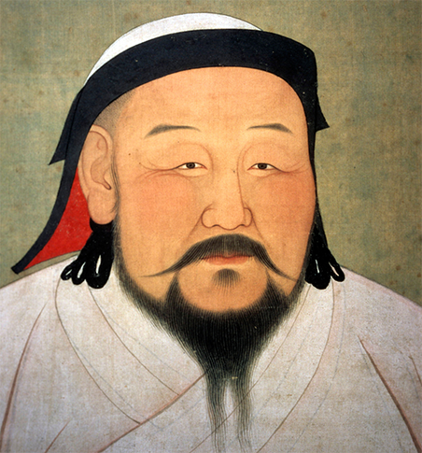
Mongols Rule China
Kublai Khan, the emperor of China, is portrayed as he was in the 1260s, an alert, vigorous, simply attired man. He wears the symbolic white robes of a Mongol shaman.

Slide 10
Chinese Rule Restored by the Ming
Ming Policies
They restore civil service system
Confucian learning returns as the road to success
Civil service test becomes harder
A board of censor watch the bureaucracy, eliminating corruption
Economic Revival
The plains of East China will support 100 million people
Better fertilization will make more crops
From America they will get corn and sweet potatoes
Chinese cities are home to many industries like porcelain, paper, and tools
The Ming will limit the extent and duration of trade with Europeans
They will only accept precious metals for their goods, affecting global trade

Slide 11
Chinese Rule Restored by the Ming
Flourishing Culture
Ming China has a revival of arts and literature
Ming artists will create their own type of landscaping painting and porcelain
Ming vase will be the most valuable and popular Chinese export
New forms of literature for the common man will emerge
They will produce novels and the first detective stories
Ming Math, Science, and Technology
In the late 15 century China was the richest civilization in the world with technology far beyond what was in Europe
Ming scholars integrated their own traditions with Western mathematics and science that they learn from Jesuit missionaries
In 1629 the emperor will allow the Chinese calendar to be reform using Western technology like telescopes
Using new technology and Jesuit help, they created new star atlas and fixed the Chinese calendar

Slide 12
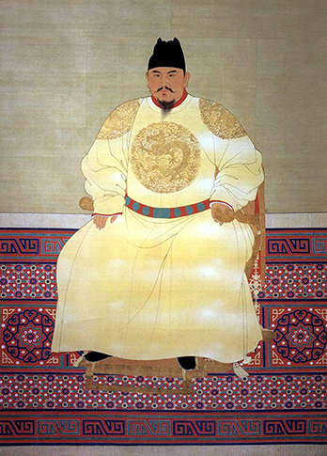
Chinese Rule Restored by the Ming
Zhu Yuanzhang ousted the Mongols and led China as the Hongwu emperor, shown here, for 30 years. He founded the Ming dynasty, which ruled China for almost 300 years.

Slide 13
Chinese Fleets Explore the Seas
The Great Fleets of Zheng He
Between 1405-1433 Zheng He made 7 expeditions in order to promote trade collect tribute from across the Western Seas
Fleet size of 62 huge ships and 200 smaller ones with a crew of 28,000 sailors. The largest ships were about 400 feet long
He explored the coast of South East Asia, India, entrance to the Red Sea, and the Persian Gulf
Chinese merchants will settle in India and South East Asia

Slide 14
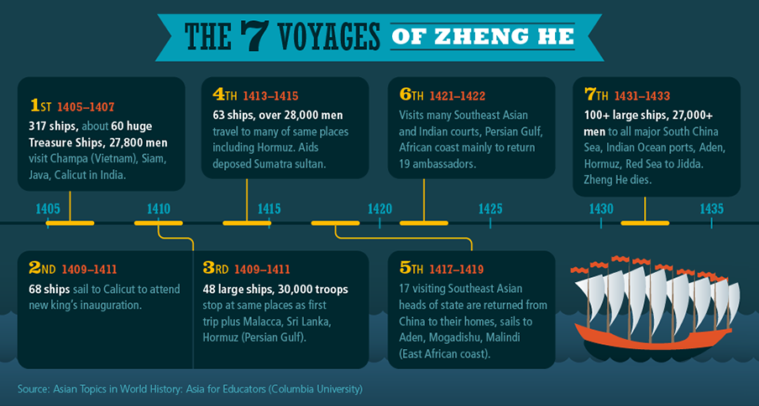
Chinese Fleets Explore the Seas
Zheng He’s epic voyages were multipurpose expeditions of exploration, diplomacy, and trade to Southeast Asia, India, and Africa. Analyze Data Which voyage had the largest number of ships?

Slide 15
Chinese Fleets Explore the Seas
The Ming Turn Inward
In 1435 the Ming Emperor will ban the building of huge ships
In the 1500’s the Ming will carefully limit the extent and duration of trade. They will demand silver and gold for goods Europeans wanted like silk, tea, and porcelain
The Ming stopped their huge navies because of cost. They did not want to mingle with outside cultures b/c they felt their society was the best in the world
They want to preserve their traditions, which they saw as a source of stability
This loyalty will weaken China. Columbus will sail west from Spain in order to find a new way to Asia

Slide 16
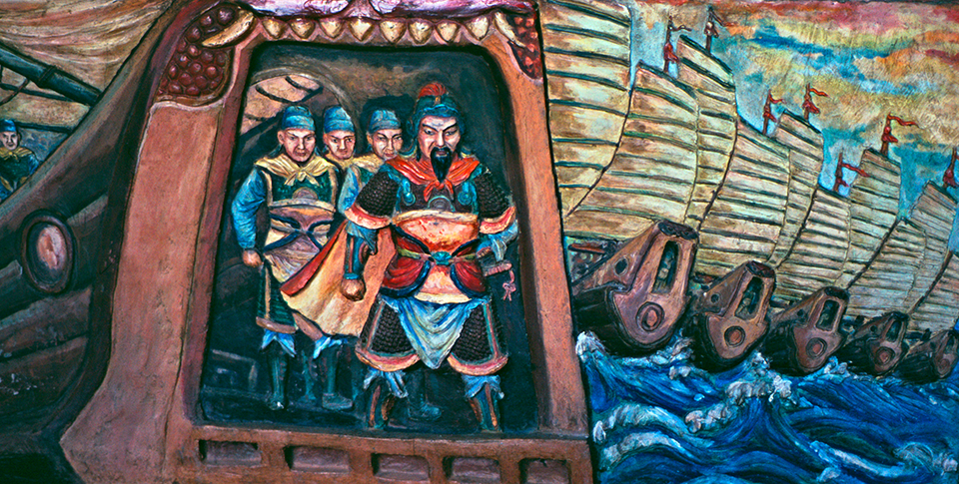
Chinese Fleets Explore the Seas
Zheng He and his crew and ships are portrayed in this colorful relief at the Gedong Batu Temple in Semarang, Java Indonesia. An annual celebration commemorates his visit.

Slide 17
Quiz: Mongols Build an Empire
How did the Mongol rulers change once their conquests were complete?
A. They were intolerant and increased the tribute people were required to pay.
B. They were not oppressive but permitted people to continue with their lives with relatively little change.
C. They were insecure and always preparing for invasion from their neighbors.
D. They were generous and eliminated the burden of paying tribute.

Slide 18
Quiz: Mongols Rule China
How did Kublai Khan organize Mongol rule in China?
A. He reserved the highest government jobs for Mongols and said that only Chinese could serve in the military.
B. He said that only Mongols could rule in the provinces and that both Chinese and Mongols could serve in the military.
C. He divided the highest government jobs between Mongols and Chinese and said that only Mongols could rule in the provinces.
D. He permitted only Mongols to serve in the military and reserved the most powerful government positions for Mongols.

Slide 19
Quiz: Chinese Rule Restored by the Ming
How did Ming rulers restore an earlier style of Chinese government?
A. They founded a new dynasty, moved the capital to Nanjing, and encouraged Buddhism.
B. They restored the civil service system and renewed the emphasis on Confucian scholarship.
C. They repaired the canal system, and new technologies increased manufacturing output.
D. They reorganized the imperial ranking system and added important government offices.

Slide 20
Quiz: Chinese Fleets Explore the Seas
What occurred in 1435 that changed China’s relationship with the rest of the world?
A. The Ming emperor prevented the building of large ships and stopped expeditions, which halted overseas exploration.
B. Zheng He explored the coasts of Southeast Asia and India and the entrances to the Red Sea and the Persian Gulf.
C. The Ming emperor expanded the building of seagoing ships for trade expeditions, thereby promoting overseas exploration.
D. A Portuguese merchant arrived in China to negotiate trade agreements and was welcomed by the Ming emperor.

